Slide 1
XAML for Windows 10: Layouts
Daren May | President, CRANK211
Jerry Nixon| Developer Evangelist, Microsoft

Slide 2
Course Topics
XAML for Windows 10: Layouts
01 | Layout Fundamentals | 03 | Effective Layouts
02 | Custom Panel

Slide 3
Effective Layouts

Slide 4
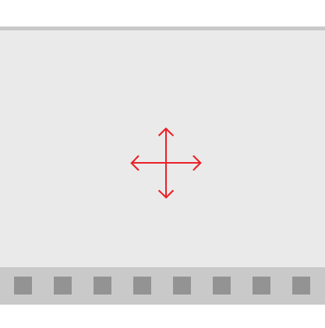
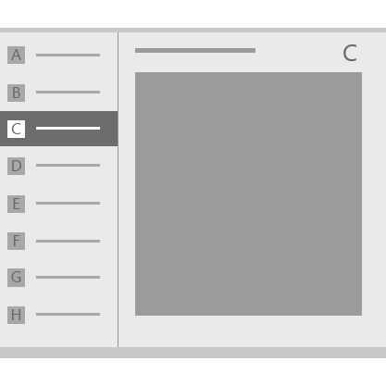
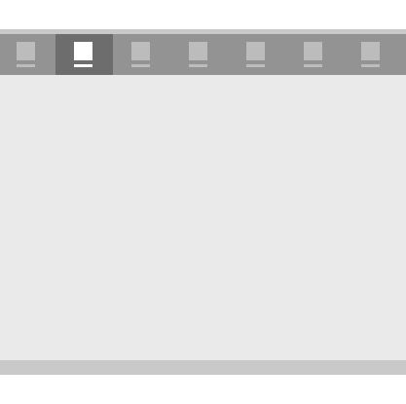
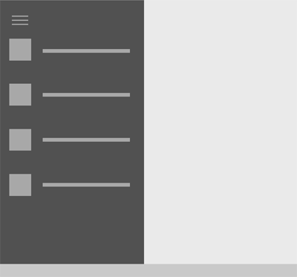
Module Overview
Active Canvas
Master/Details
Tabs and Pivots
Nav Panel

Slide 5

What is Template 10?
An open source framework providing boilerplate code
Helps handle navigation between pages
Extremely useful for any non-trivial application
Hosted on GitHub delivered via NuGet
https://github.com/Windows-XAML/Template10
Install via VS 2015 Tools – Extensions and Updates – Online – T10
App templates hosted on Visual Studio Gallery delivered via a Visual Studio Extension (VSIX)
https://visualstudiogallery.msdn.microsoft.com/60bb885a-44e9-4cbf-a380-270803b3f6e5

Slide 6
Active Panel

Slide 7
Active Panel
https://msdn.microsoft.com/en-us/library/windows/apps/dn997761.aspx
Notes:
Single View
Document Viewing/Editing – paint, mapping, games
Minimal if any navigation

Slide 8
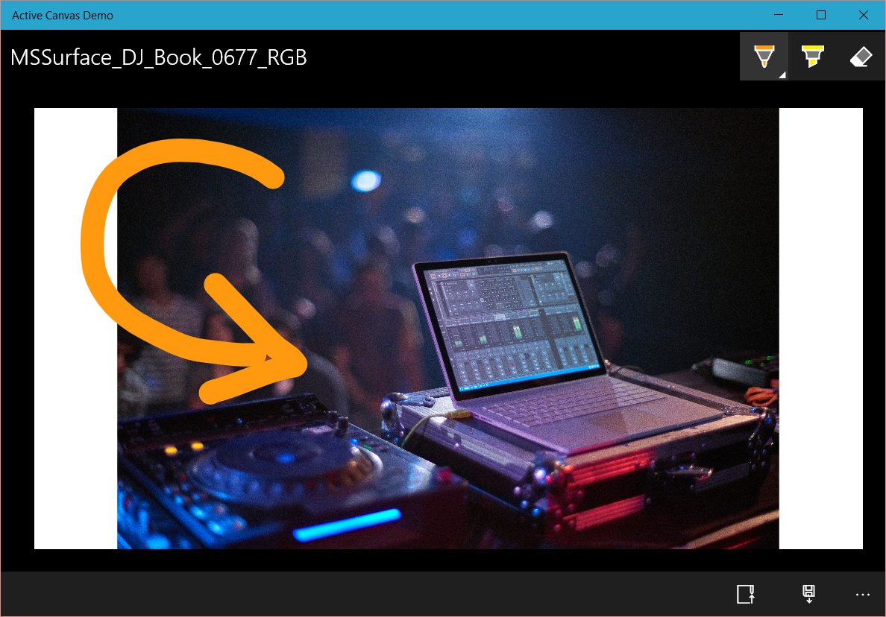

Slide 9
Active Panel

Slide 10
Master/Detail

Slide 11
Master / Detail
https://msdn.microsoft.com/en-us/library/windows/apps/dn997765.aspx
Notes:
Side by side viewing of a list of items and content - mail
Collapses to a drill down on small screens
Great for hierarchal navigation
Other things -

Slide 12
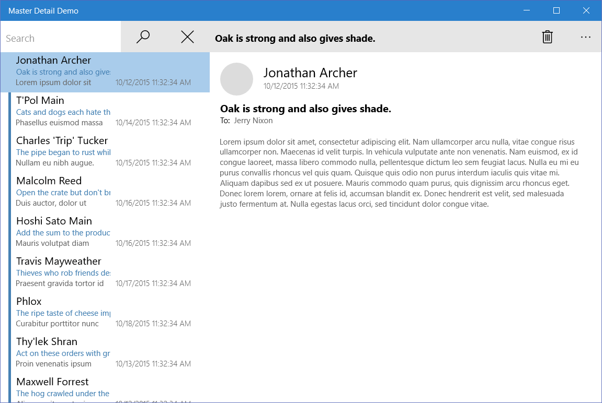

Slide 13
Master / Detail

Slide 14
Tabs and Pivots

Slide 15
Tabs and Pivot
https://msdn.microsoft.com/en-us/library/windows/apps/dn997788.aspxs
Notes:
Tabs and pivots are used for navigating frequently accessed, distinct content categories

Slide 16
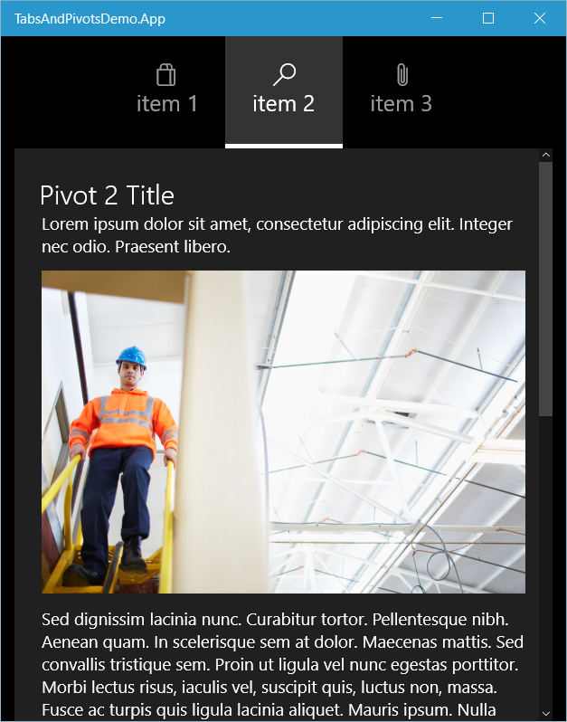

Slide 17
Tabs and Pivots

Slide 18
Nav Pane

Slide 19
Nav Pane
https://msdn.microsoft.com/en-us/library/windows/apps/dn997766.aspx
Notes:
Great for multi-level navigation
Uses SplitView (aka Hamburger Menu)
Lots of different menu styles

Slide 20
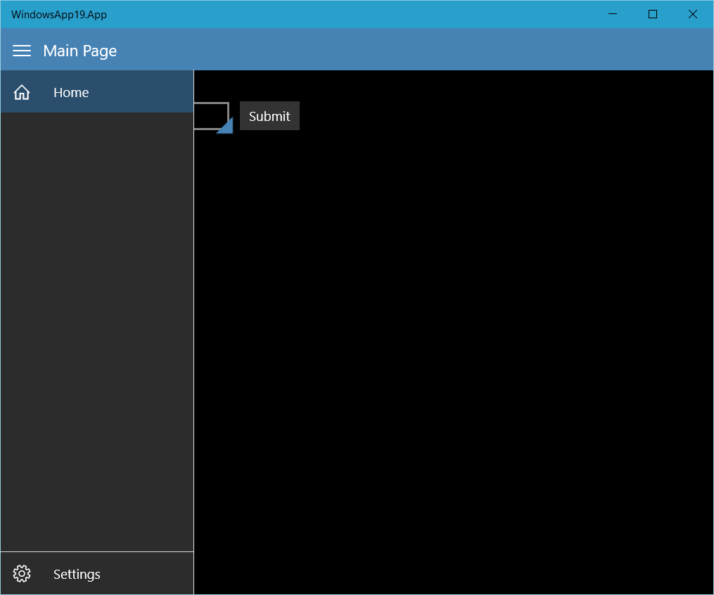
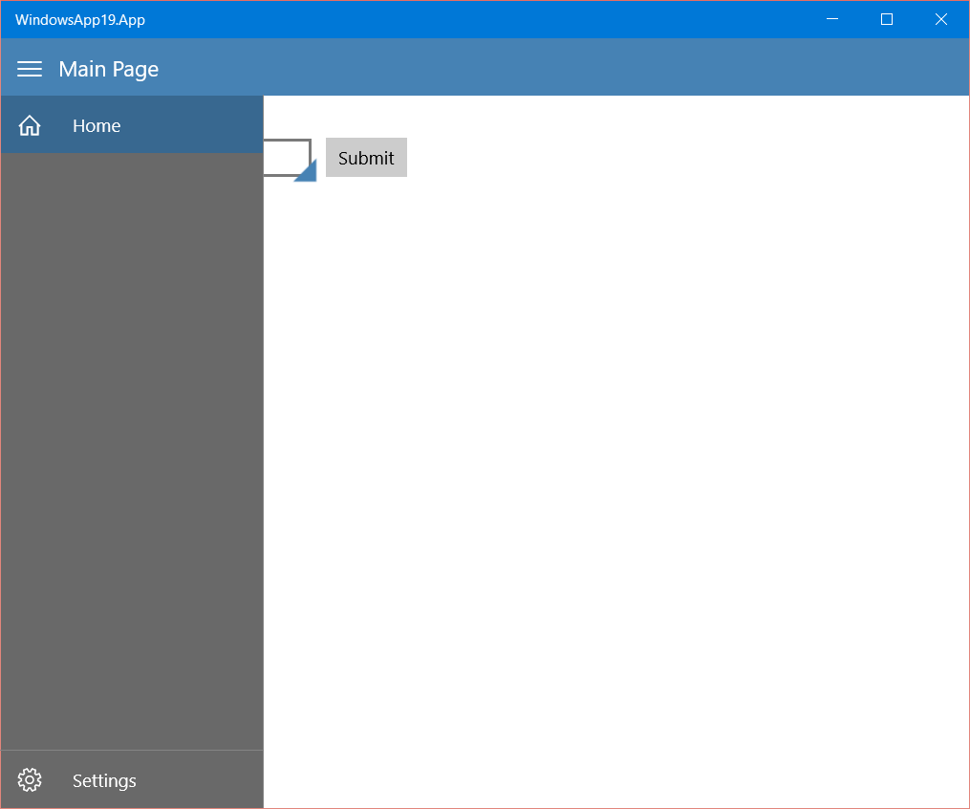

Slide 21
Nav Pane

Slide 22
Summary
Active Canvas
Master/Details
Tabs and Pivots
Nav Panel

